Slide 1
Queues
C. Oswald & Preeth R
VIT Chennai
The class notes are a compilation and edition from many sources. The faculty does not claim intellectual property or ownership of the lecture notes.

Slide 2
Queues
Queue is a container of objects – another form of restricted list of elements
First-in first-out principle (FIFO)
Any waiting line is a queue:
The check-out line at a grocery store
The cars at a stop light
An assembly line
Elements enter the queue at the rear and removed from the front

Slide 3
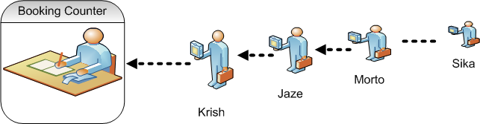
Graphical Representation of a Queue

Slide 4
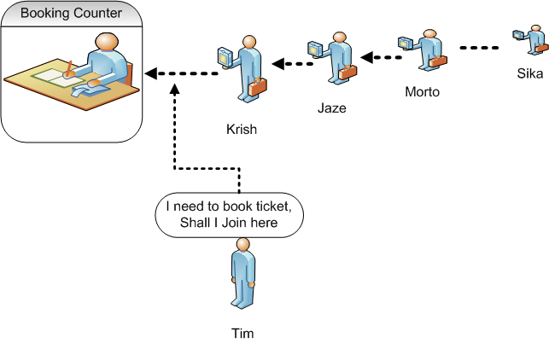
Graphical Representation of a Queue

Slide 5
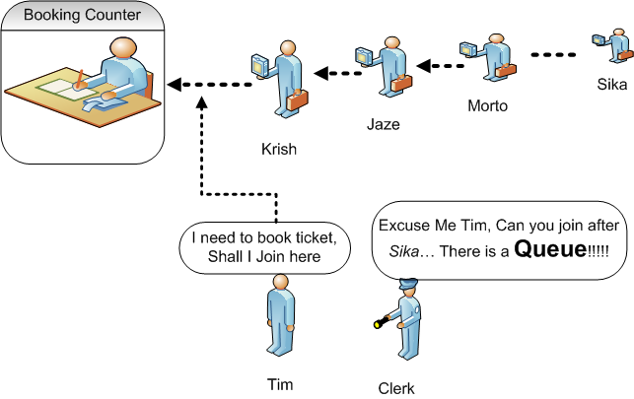
Graphical Representation of Queue

Slide 6
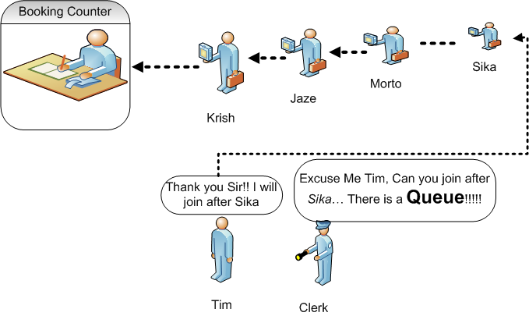
Graphical Representation of Queue

Slide 7
Uses of Queues in Computing
For any kind of problem involving FIFO data
Printer queue (e.g. printer in MC 235)
Keyboard input buffer
GUI event queue (click on buttons, menu items)
To encode messages
Ref: https://www.csd.uwo.ca/Courses/CS1027b/notes/CS1027-Queues-W17.pptx

Slide 8
Uses of Queues in Computing
In simulation studies, where the goal is to reduce waiting times:
Optimize the flow of traffic at a traffic light
Determine number of cashiers to have on duty at a grocery store at different times of day
Other examples?

Slide 9
Queue Abstract Data type
Defines a container, where element access and deletion are restricted to the first element in the sequence
Deletion at the front of the queue and Insertion at rear of the queue
Insert (Enqueue)
Remove (Dequeue)
front
rear

Slide 10
Queue Abstract Data Type
Enqueue(o): Insert objects o at the rear of the queue
Input : Object ; Output : Updated Queue.
Dequeue(): Remove and return from the queue the object at front
Input : None; Output : Object.
Size(): Return the number of objects in the queue
Input : None; Output : Integer.
Is Empty():Return a boolean value indicating if the queue is empty
Input : None; Output : boolean.

Slide 11
Array based implementation
Create an Array, Q, with capacity n for storing its elements, (n=1000)
Consider two variables front and rear, which will be initialized to -1. (i.e., queue is empty)
Naïve way
When enqueuing, the front index is always fixed and the rear index moves forward in the array.
Q[0] be the front of the queue and the queue grow from there

Slide 12
Array Implementation of Queue
Naïve way
When enqueuing, the front index is always fixed and the rear index moves forward in the array.
When dequeuing, the element at the front the queue is removed. Move all the elements after it by one position. (Inefficient!!!)
Rear = 1
Rear = 0
Rear = -1
6
9
9
Front =0
Front = 0
Front = -1
Dequeue()
Dequeue()
Dequeue()

Slide 13
Array Implementation of Queue
Better way
When an item is enqueued, make the rear index move forward.
When an item is dequeued, the front index moves by one element towards the back of the queue (thus removing the front item, so no copying to neighboring elements is needed).
(front)
XXXXOOOOO (rear)
OXXXXOOOO (after 1 dequeue, and 1 enqueue)
OOXXXXXOO (after another dequeue, and 2 enqueues)
OOOOXXXXX (after 2 more dequeues, and 2 enqueues)
The problem here is that the rear index cannot move beyond the last element in the array. (Shall discuss after few slides)

Slide 14
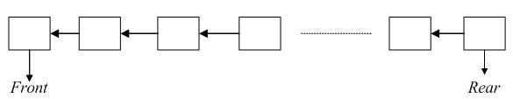
Queue: Example
Sample Illustration
The queue grows towards the right from the left
Two indices namely front and rear are used to traverse the elements.
Consider a example of queue with size n=5

Slide 15



Queue: Example
enqueue(5)
enqueue(3)
enqueue(10)

Slide 16


Queue: Example
Dequeue()
enqueue(7)

Slide 17

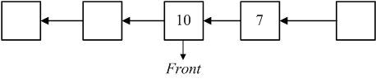
Queue: Example
Dequeue()
After performing the dequeue operation

Slide 18


Queue: Example
Enqueue(2):
Now, rear == n-1, So the queue is full (i.e., Overflow)

Slide 19
Array based implementation
Enqueue(obj): If rear < n-1 , it indicates that the array is not full then store the element at Q[rear] and increment rear by 1
Enqueue(obj): If rear == n-1, then the array is full and is said as queue overflow condition
Dequeue(): The element at Q[front] will be deleted, if rear >= 0 (i.e., the queue should have atleast one element in it)

Slide 20
Array based implementation
Front(): Returns the reference to the front element in the queue( i.e., Q[front] if queue is not empty)
Time Complexity:
Enqueue(Insertion): O(1)
Dequeue(Deletion):O(1)
Dequeue(Deletion):O(n) { Array implementation of Queue in efficient manner}

Slide 21
Isempty()
# define Q[n]
int front = rear=-1;
Void Isempty ()
{
If(rear==-1 && front== -1)
{
return true
else
return false;
}

Slide 22
Enqueue(int x )
Void enqueue (int x)
{
If(rear==n-1)
printf(“Overflow”);
else if(front==-1&&rear==-1)
{
Front=rear=0;
Q[rear]=x;
}

Slide 23
Enqueue(int x)
else
{
rear++;
Q[rear]=x;
}
}

Slide 24
Dequeue()
void dequeue()
{
if(rear==-1 ||front>rear)
printf(“Underflow”)
else
{
element=Q[front];
printf(Element);
front++;
}

Slide 25
Implementation using Circular Array
Using a circular array
When an element moves past the end of a circular array, it wraps around to the beginning, e.g.
OOOOO7963 → 4OOOO7963 (after Enqueue(4))
After Enqueue(4), the rear index moves from 3 to 4.

Slide 26
Circular Queue
Linear data structure in which the operations are based on FIFO(First In-First Out)
It is also called as Ring buffer
Instead of ending the queue at the last position, it again starts from the first position after the last, hence making the queue behave like a circular data structure

Slide 27
Circular Queue
The circular queue was devised to limit the memory wastage of the linear queue
The new element is added at the very first position of the queue if the last is occupied and space is available.
The time complexity is O(1) for all the operations

Slide 28
Conceptual example of a Circular Queue
front
After 5 dequeues
1
After 7 enqueues
1
0
0
front
12
12
11
rear
11
rear
10
10
rear
1
0
front
12
11
After 8 more enqueues
10

Slide 29
Circular Array Implementation of a Queue
3
2
3
1
4
front
queue
5
cq
0
7
5
n-1
6
rear
count
n-2
7
n-3
8
.
9
.
.
10

Slide 30
A Queue Straddling the End of a Circular Array
98
2
3
1
4
front
queue
5
cq
0
1
4
99
6
rear
count
98
7
97
8
.
9
.
.
10

Slide 31
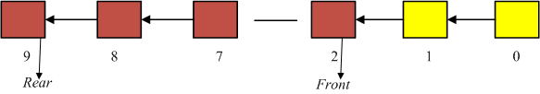
Operations: Circular Queue
When the rear end fills up and front part of the array has empty slots, new insertions should go into the front end
Consider the size n of queue Q as 10. The yellow coloured slots remain empty and brown coloured slots are having values in it.

Slide 32
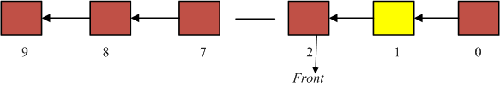
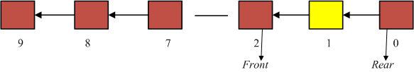
Operations: Circular Queue
The next insertion goes into slot 0, and rear tracks it.
After One Call to enqueue()

Slide 33
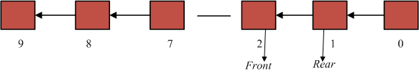
Operations: Circular Queue
After One Call to enqueue()
Now, the queue is full. So, memory wastage is avoided in circular queue, which leads to better performance.

Slide 34
Numeric for circular queue
front increases by (1 modulo size) after each dequeue( ):
front= (front+1)%size
rear increases by (1 modulo size) after each enqueue( ):
rear= (rear+1)%size

Slide 35
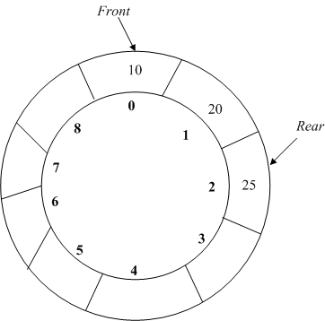
Illustration of Circular queue

Slide 36
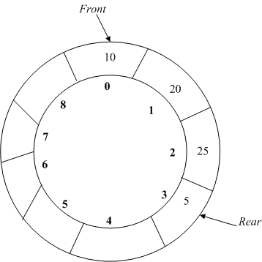
Enqueue(int x)
To add an element in circular queue, move rear clockwise
Then put it into Q[rear]

Slide 37
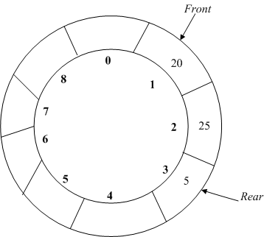
Dequeue()
To remove an element in circular queue, move front clockwise
Then extract it into Q[front]

Slide 38
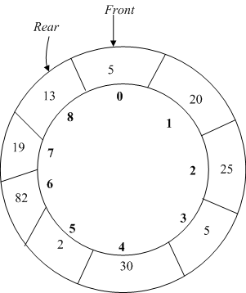
Isfull()
Check whether queue is Full:-Check ((rear == SIZE-1 && front == 0)
Is that alone sufficient??

Slide 39
Isfull()
Check whether this condition also holds, i.e. (rear == front-1)
Two conditions to be checked.((rear == SIZE-1 && front == 0) || (rear == front-1)).
If queue is not full then, check if (rear == SIZE – 1 && front != 0) if it is true then set rear=0 and insert element

Slide 40
enqueue(int x)
void enQueue (int value)
{
if ((front == 0 && rear == size-1) ||
(rear == (front-1)%(size-1)))
{ printf("\nQueue is Full");
return; }
else if (front == -1) /* Insert First Element */
{ front = rear = 0;
arr[rear] = value;
}

Slide 41
enqueue(int x)
else if (rear == size-1 && front != 0)
{ rear = 0;
arr[rear] = value;
}
else {
rear++;
arr[rear] = value;
}
}

Slide 42
dequeue()
int deQueue()
{
if (front == -1)
{
printf("\nQueue is Empty");
}
int data = Q[front];

Slide 43
dequeue()
if (front == rear) {
front = -1;
rear = -1;
}
else if (front == size-1)
front = 0;
else
front++;
return data;
}

Slide 44
Applications
CPU Scheduling is a process of determining which process will own CPU for execution while another process is on hold
First Come First Serve Scheduling
In this type of algorithm, the process which requests the CPU gets the CPU allocation first. This scheduling method can be managed with a FIFO queue.

Slide 45
Thank You

